Slide 1

Slides for Courses Using the Business Intelligence Guidebook
From Data Integration to Analytics
by
Rick Sherman
www.biguidebook.com

Slide 2

Business Intelligence Guidebook – From Data Integration to Analytics
www.biguidebook.com
November 2014
Imprint: Morgan Kaufmann
Print Book ISBN : 9780124114616
eBook ISBN : 9780124115286

Slide 3
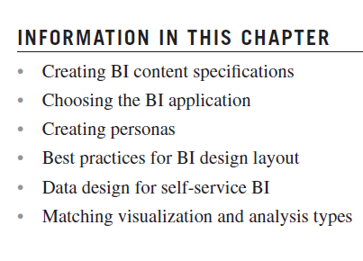
Chapter 13 Business Intelligence Applications

Slide 4
BI Content Specifications
The project team needs to develop BI content specifications in order to design and document the BI applications they are going to build.
The requirements gathering processes discussed in Chapter 3 will have collected the preliminary content for the specifications, but more details are needed, and the input from the requirements must be organized in the context of the BI applications.
The specification is a tool to help in the design, development, and maintenance of each BI application.
The specification is a living document that will be updated and modified at various points in the project as designers, developers, and business people (its consumers) discover different aspects of the BI application.
The BI application content specification includes the following: BI content specification (page 338) .

Slide 5
Revise BI Applications List (Choosing BI application)
Create the initial list of BI applications by reviewing the data and business requirements gathered earlier in the project.
The BI content specification process will help you create a revised and agreed-upon list of BI application deliverables. The revisions will evolve during the following steps:
1. Assessing scope
Defining the BI content specifications involves categorizing the BI applications, getting the business to set priorities, and estimating the level of effort to create them.
The BI team members developing the specifications will need to coordinate with data modelling and data integration efforts.
Review any data schemas that will be used by the BI applications.
BI application design (especially if prototyping is involved) and BI development efforts will need to have BI data stores populated with data, even if it is just sample or test data to begin with.
Identify and document project dependencies and risks in the BI application specifications.

Slide 6
Revise BI Applications List (Cont.)
2. Consolidating BI applications
Refine the initial list of BI applications to be delivered during the BI content specification process.
Examine each of the individual BI applications in the context of the entire list.
First, there are often overlapping requirements across multiple BI applications that can be consolidated into a single BI application with the use of filtering or parameters.
Second, the use of more self-service oriented BI analytical styles, such as data discovery, OLAP, and in-memory columnar analytics, enable what appeared to be separate BI applications to be viewed on a dashboard.
Both of these scenarios are very common when legacy reports are included in the mix of BI deliverables.
Do not be intimidated if there are hundreds or even thousands of legacy reports to be migrated; Some projects had consolidation ratio of 10 to 1. This is likely to be the only time during the BI project where BI deliverables will be reduced rather than expanded.

Slide 7
Revise BI Applications List (Cont.)
3. Reviewing specifications
The consolidated list of BI applications with their content specifications needs to be reviewed by the business stakeholders and reporting subject matter experts (SMEs) to provide feedback and confirm or refine deliverables.
In addition, the project dependencies and risks must be reviewed within the context of business priorities to determine if any adjustments need to be made to the list of deliverables, the schedule, or project resources.
4. Creating an agreed-upon BI deliverables list.
This milestone reflects the exit criteria for the BI content specification process and, more importantly, BI scoping.
With the agreed-upon list in place you can proceed with the tasks of data modelling, data integration, and BI development.

Slide 8
Creating BI Personas
In almost every industry, marketing groups perform customer segmentation analysis for their companies to sell products or services targeted at specific segments.
The key to success, just like in marketing, is to target the BI application to the correct customer segmentation.
We refer to the characteristics of a segmentation of business people as a persona.
Product vendors and IT personnel have been frustrated for years that they have not been able to get BI to be pervasive throughout an enterprise. The key to making it pervasive is to identify the BI personas, determine what tools support them, and then structure BI applications for them.
The business personas are:
Casual consumers
Analysts
Power users
Data scientists

Slide 9
Creating BI Personas Casual Consumers
Many, if not most, of the people in an enterprise are casual consumers of analytics.
These business people will use pre-built reports and dashboards to obtain information they need to perform their jobs.
If filters or parameters need to be input in order to obtain their specific data, then they would prefer to save the settings so they do not have to remember them for the next time.
Casual consumers may range from operations staff to executives.

Slide 10
Creating BI Personas Analysts (Business analysts, financial analysts, sales analysts, etc.)
The analyst persona includes people in an enterprise who regularly use BI applications to gather and explore data they need to perform their jobs. Data analysis is in their job descriptions. The job titles may include the word “analyst” (business analyst, financial analyst, sales analyst, operations analyst, etc.) but many other managerial or staff jobs also apply.
Analysts will leverage their business knowledge to explore and analyze data using spreadsheets and BI applications.
They are quite comfortable using pivot tables, so BI applications that present data in that context are easy for them to use. A wide range of BI styles present data in this context, including OLAP cubes, in-memory columnar data, discovery, data visualization, dashboard, scorecard, and report tools.
Analysts typically use a dashboard or report template rather than building it from scratch. They will drag the dimensions and measures presented in the power pivot palette onto the templates to perform their analysis. Analysts will also typically use existing data models, but may augment those by adding calculated measures or augmenting the data with something from a spreadsheet.
Analysts offer the most significant opportunity for the BI application to expand and increase its overall business ROI because they are underserved in most enterprises, yet their job role means they would benefit from becoming BI application consumers.

Slide 11
Creating BI Personas Power Users (Combine the business needs of analyst persona as well as IT skills, usually develop data shadow systems)
Power users have always been the sweet spot for BI sales, as they have the business needs of the analyst persona, but they also love technology.
These people are the departmental experts in the BI tools that have been bought, and they are their core enterprise customers.
Because their efforts to build and enhance BI applications gives them a pseudo IT role, they take the time to learn all the BI tools’ features and keep asking for more.
Although power users are the core of an enterprise’s BI efforts, they present risks to those efforts:
First, their skills and enthusiasm for BI tools does not represent those of the other business people. BI applications should be positioned to support the power users but, more importantly, support the rest of the business community.
Second, power users are the people who have been creating data shadow systems for years. These systems provide them with their gravitas with their peers and managers—something they are not likely to give up easily. Keep in mind that power users may build their next data shadow system with the BI tools rather than a spreadsheet. With that in mind, make sure that migration of legacy reporting and data shadow systems are part of the deliverables for BI projects.

Slide 12
Creating BI Personas Data Scientists
These are the data and statistical geeks. Data scientists work with predictive analytics.
Predictive analytics moves BI from merely analyzing the past and present to leveraging that knowledge to predict outcomes.
Data scientists know statistics and math, but what is often overlooked is their expertise in their enterprise’s business and industry. They may also have expertise in psychology, economics, or other disciplines that help build predictive models.
The size of the data scientist population in most enterprises is small, but their business impact may be significant. This book covers predictive analytics and how to build BI applications for the data scientist persona in Chapter 15.

Slide 13
Best Practice for BI Design Layout
This section discusses how to design the applications so they are intuitive and functional:
First, focus on the purpose
Second, follow design layout best practices

Slide 14
Best Practice for BI Design Layout Focus on the Purpose
The BI team identifies the who, what, where, and how of each BI application in the BI content specifications and establishes its specific purpose.
Designing the application should begin with finding the area focus up front and then ensuring that it will be adhered to.
The business person will inevitably ask for more, tempting the BI developer to expand the focus, but that should be avoided at all costs. If new purposes arise, then the BI team needs to determine if it needs to develop new BI applications to fulfil those requirements.
BI design techniques, such as wireframes, mockups, and prototyping, are extremely useful in getting business feedback and in maintaining focus on the purpose of the application.

Slide 15
Best Practice for BI Design Layout Design Layout
Follow these basic design layout practices when developing BI applications:
Consistency beats elegance
The BI team should develop a template layout for each BI style deployed in BI applications.
The layouts should be as consistent as the variation in BI styles allows.
The template should include standard positioning for titles, legends, navigation tools, help, and visual elements, such as icons and text styles.
There should also be a standard background and branding such as a company or product logo.
Business people should feel that each BI application is familiar in both layout and navigation, which improves their productivity and allows them to concentrate on the analysis rather than on the application.
In addition, developing templates improves the productivity of the BI team, speeds up BI delivery, and decreases maintenance costs.

Slide 16
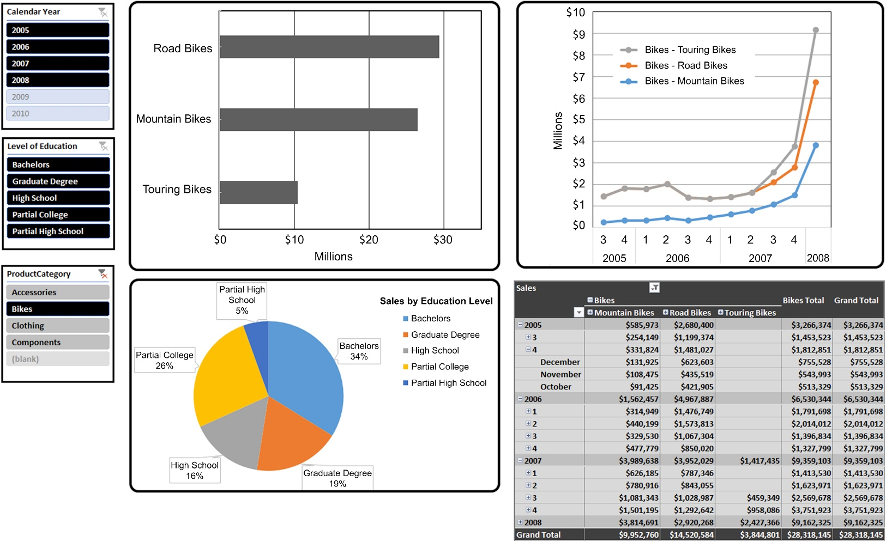
Dashboard example 1
Figure 13.1 depicts a standard template designed by a BI team for a product marketing group.
Design elements that are standardized in this example include:
Filters located on the upper left corner of the display.
Comparison and contribution analysis presented in two left-hand quadrants. Data is aggregated and drillable when there is a dimensional hierarchy.
Trending analysis presented as a line chart in the upper right quadrant.
Sales data presented in tabular form in the lower right quadrant.
f13-01

Slide 17
Best Practice for BI Design Layout Design Layout (Cont.)
Keep it simple
There is a temptation to try to cram too much information or too many visual elements onto a BI application’s display
Creating too much visual clutter makes it more difficult or sometimes impossible to work effectively.
Do not be afraid of white space, as it is not a sign of weakness; rather, it shows restraint. The term data-ink ratio identifies the relationship between data and white space.
Business people should be able to determine at a glance what elements on the layout they are going to work with.

Slide 18
Best Practice for BI Design Layout Design Layout (Cont.)
Location, location, location
Place the most important data at the top of the dashboard, in particular the upper left-hand corner, which is where a person’s eyes travel first.
If visualizations are linked together to support a particular business analysis, then the workflow should be from top to bottom and from left to right.
This workflow places the last visualization at the bottom or bottom right of the layout.

Slide 19
Best Practice for BI Design Layout Design Layout (Cont.)
Use colors judiciously
Colors can be used very effectively to enhance the understanding of data, but they can also become a distraction or even a hindrance.
It is very common to encode or associate colors with specific values of something, such as a different color for each product category displayed on a line chart.
In addition, making a color hue darker or increasing the size of an object on a chart can portray increasing values, such as sales or income.
Always keep in mind that the layout needs to be understandable even if only seen in grayscale in order to accommodate people who are color blind, or when the display has been printed (or saved to a PDF document) without color.

Slide 20
Best Practice for BI Design Layout Design Layout (Cont.)
Use colors judiciously (Cont.)
There are several guidelines:
Use a limited number of colors, as too many colors makes it impossible to discern how the data has been encoded. Also limit the number of color palettes in the layout to no more than two.
Color gradients are effective in displaying differences in measures’ sizes or rankings. This technique can reduce the total number of visualizations necessary to convey information and can also reduce the number of colors needed.
Use contrasting colors rather than colors with slightly different hues, as it will be difficult to distinguish between the colors.
Color schemes should represent distinct things on the single display. Overlapping color schemes on different views creates confusion because the same color is used to represent two different things.
Use colors conventionally whenever possible. The best example is to use the color green for positive values such as business profits and the color red for negative values such as business losses. This enables the business person to mentally encode the visualization without the need for any legend or other visual cue.

Slide 21
Best Practice for BI Design Layout Design Layout (Cont.)
It looked great on my monitor
Many data visualization tools enable the dashboard to be designed once and deployed on many platforms, such as PC, tablet, and smartphone.
These devices range in size from huge wide-screen monitors to handheld phones and will also vary in display quality.
Dashboards designed on a huge wide-screen monitor may look very compelling, but may be too cluttered on the typical notebook’s screen and impossible to use on a tablet.
If the BI applications are planned to be deployed on multiple platforms, then the developer needs to prototype the layout on each of those platforms from screen size and display quality perspectives.

Slide 22
Best Practice for BI Design Layout Design Layout (Cont.)
Limit the visualizations on a single layout
The classic dashboard has four visualizations or charts that are related to each other in a business context.
If the layout starts adding more than four visualizations, it gets cluttered, the data-ink ratio goes astray, visualizations get smaller, and the overall usefulness of the BI application decreases.
If additional visualizations are linked to one of the four selected for the BI applications layout, you should place those visualizations on another dashboard or report.

Slide 23
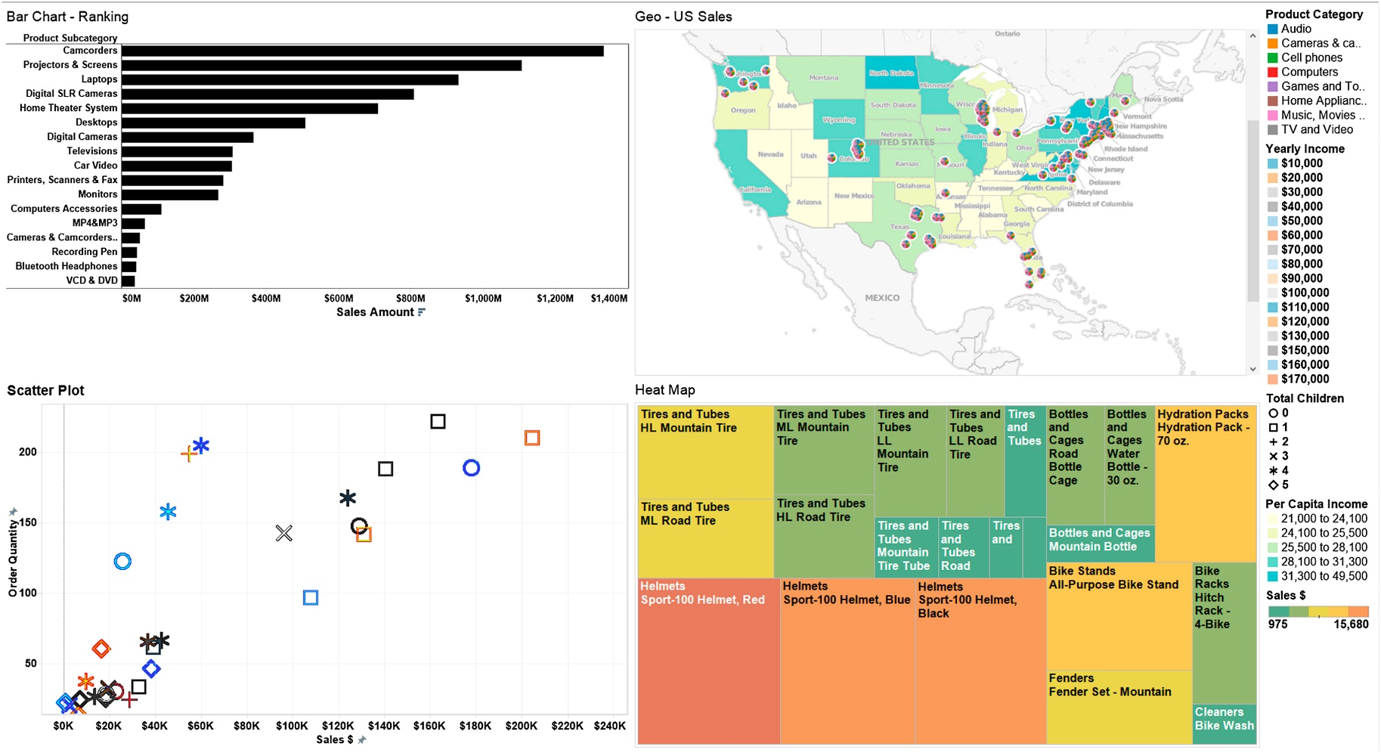
Dashboard example 2
Figure 13.2 depicts a different standard template designed by a BI team for a product marketing
group. This template uses a:
Bar chart for ranking analysis.
Geomap for sales.
Scatter graph for correlation analysis.
Heat map for contribution analysis.
f13-02

Slide 24
Best Practice for BI Design Layout Design Layout (Cont.)
Leverage filters and slicers
Filters enable business people to customize their data discovery and exploration within a BI application. They allow business people to reduce the data set into more detail. There are several guidelines:
It is best to apply filters to all visualizations in a layout. This avoids different visualizations using different filters, which would be misleading. For example, if there is a product category filter, then all the visualizations with the product category should only display those filtered product categories.
Filters are typically implemented by selecting from a list of values; however, deep and numeric values are best displayed by using a sliding bar filter.
Visibly display filters that are in use so that the business person knows what they are saying in the visualizations. In addition, dynamic titles that include filters that were applied are often useful if the number of values is limited.
If attributes being used in filters have hierarchies, then the filters should be displayed in hierarchical order from highest to lowest. Filter values applied in a hierarchy should cascade to all levels of the hierarchy.
If a filter value list is lengthy, it may be useful to include all or none options in the filter list.

Slide 25
Best Practice for BI Design Layout Design Layout (Cont.)
Use legends judiciously
Legends are another visualization that can lead to clutter if overused.
Only use legends when needed to understand a visualization such as when colors aren’t labeled.
Also, many times visualizations that are related to each other may be able to share the same legend. When using a common legend for multiple visualizations, make sure it is visible everywhere it is needed.
Outliers should be flagged
Assuming that outliers are the exception rather than the rule on the display, then there should be a visual cue indicating that it is an outlier. These cues may involve using color, size, boldness, highlighting, or icons.
The outliers may represent the best and/or worst measure values, depending on what the business is interested in tracking.

Slide 26
Best Practice for BI Design Layout Design Layout (Cont.)
Make it easy to read labels
Horizontal labels are much easier to read than vertical labels.
Consistent text style, fonts, and size also adds to readability.
Scrollbars
Typically it is best to avoid scrollbars because it is difficult to ascertain the full context of the data being presented.
If the business person does need to see a tabular data grid, then consider linking to a stand-alone grid from the initial dashboard.

Slide 27
Data Design for Self-Service BI
The data presented in each BI application must be designed in the context of the ease-of-use and functionality that is appropriate for its intended use and audience.
In the previous section, you read that cluttered and poorly designed visual layouts can hinder business analysis. It’s the same with data layouts.
When the data model that business people see when using the BI application is cluttered and poorly designed, it makes it much harder to use. We will refer to this as the BI presentation model.

Slide 28
Data Design for Self-Service BI The Last Data Preparation Step
Most BI tools present data to the business people in the context of a dimensional model, displaying the data as dimensions and measures (or facts).
This context exists regardless of the data structure of the data sources the BI tool is accessing.
In addition, hierarchies can be created by linking dimensions together, new measures can be derived by performing functions on other measures, entities can be renamed, and things can be hidden from view.
All of this information is stored in the BI tool’s repository. The dimensional model with all of its modifications results in the BI presentation model that business people see when using the BI applications.

Slide 29
Data Design for Self-Service BI The Last Data Preparation Step (Cont.)
Two approaches for the BI presentation model are:
Vertical—it is tailored to meet the needs of its BI application just like the visualizations and analytical functionality. It is geared toward a specific business group and the functions that they perform. This is a vertical orientation with the same people performing different functions. Examples include the accounts receivables (A/R) or the sales group.
Horizontal—it focuses on a specific business process. This is a horizontal orientation with one process supported by people who work across different business groups. Examples include supply chain management and budgetary planning.

Slide 30
Data Design for Self-Service BI The Last Data Preparation Step (Cont.)
Just as a dashboard overloaded with irrelevant or inappropriate visualizations is distracting, an overloaded BI presentation model is also a hindrance. The project team can build relevancy into the BI presentation model by:
Eliminating clutter. When a business person is performing analysis, it is best to have available relevant dimensions or measures rather than have to sort through dozens of irrelevant choices. For example, if the business person is interested in sales data, then manufacturing measures will not be useful.
Using business terminology. The dimensions and measures should use the names and terminology of the people who will be using it. Although the BI team or source system applications may have well-thought-out data-naming conventions, what the business people see is not the database column name, but the name they use.
Prebuilding hierarchies and business-specific measures. During data discovery, the project team should have uncovered the hierarchies and business-specific measures that are being used in the business process or analysis being supported.

Slide 31
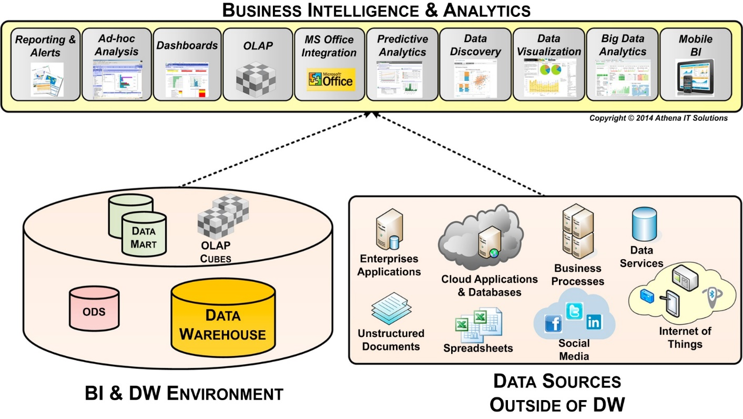
Data Design for Self-Service BI When Inconsistency is Reintroduced
BI applications can be built to access a wide variety of data sources as depicted in Figure 13.3.
One group of data sources is the BI environment that may include operational data stores (ODS), EDW, data marts, and OLAP cubes.
Each of these data stores was created using data integration processes that generated the information 5 C’s, so along with the steps we just discussed the business people will have consistent and relevant data.
The other group of data sources comes from the operational environment with enterprise applications, cloud applications, unstructured data, spreadsheets, databases, or files. These data sources may be terrific for operational reporting, but when used together, may result in inconsistent or incompatible data.
f13-03

Slide 32
Data Design for Self-Service BI When Inconsistency is Reintroduced
The best practice is to work with the business people who are going to be involved with self-service BI and discuss what data sources from the operational and BI environments they plan to intermix.
The BI team should perform data profiling and data discovery on the operational data sources, if they have not done so already, when building the BI environment. From the data profiling and discovery activities you can classify the operational data in the following categories:
Data augmentation. The operational data sources do not overlap any existing BI data source and expand the amount of data that can be used for analysis while retaining consistency.
Data consistent but semantically different. The operational data source does augment the BI environment; however, due to naming or other metadata differences, it may be difficult for the business people to conduct their analysis. In this case, the BI team should assist the business people by creating consistent semantics within the BI presentation model.
Data consistent but not able to link together. The operational data sources have relevant data but it does not have the form or relationships to support the dimensions and measures presented in the BI application. In this case, the BI team may expand an ODS, EDW, or data mart, depending on the scope of the data involved, to integrate the data into a dimensional model.
Data is inconsistent. Sometimes the operational data and BI data sources are not consistent or compatible. Under these circumstances, the BI team and business people using the BI application must discuss the issues. Then the business people must decide which data is more valid for their business analysis.

Slide 33
Data Design for Self-Service BI OLAP Cubes and In-Memory Columnar Databases
BI tools support various BI analytical styles that use OLAP cubes or in-memory columnar databases as one or more of their BI data sources.
Both require building a logical data model to present the data to business consumers, even though they have different underlying physical structures.
OLAP cubes and in-memory columnar databases require mapping and then loading data from relational databases, flat files, spreadsheets, or other data sources. Some BI tools enable the mapping and loading of these data structures with data integration tools, but most require the use of their own tools pecific utilities. In the case of data discovery tools and spreadsheets, often the responsibility rests with the business person using the BI tool.
Although BI tools are optimized to work with a dimensional model, the reality is that they will work without one or with a poorly constructed schema. Without a dimensional schema, business people are basically using the equivalent of a series of flat or denormalized tables, which limits the tool’s effectiveness for their business analysis and lessens their productivity. Unfortunately, many proofs of concept and pilots use a limited

Slide 34
Data Design for Self-Service BI OLAP Cubes and In-Memory Columnar Databases (Cont.)
The best practice is to designate a BI team member to be responsible to define and create the dimensional models that will then be loaded into the OLAP cubes or in-memory columnar databases.
The BI team should work with the business people using the BI application to then fine-tune the BI presentation model for effective business analysis.

Slide 35
Matching Types of Analysis to Visualizations
When designing the BI application, keep in mind the type of analysis that the business person needs it to perform. This will help you choose the best type of chart to optimize visualization. The most common types of analysis performed include:
Comparative
Time-series or trending
Contribution
Correlation
Geographic data
Distribution

Slide 36
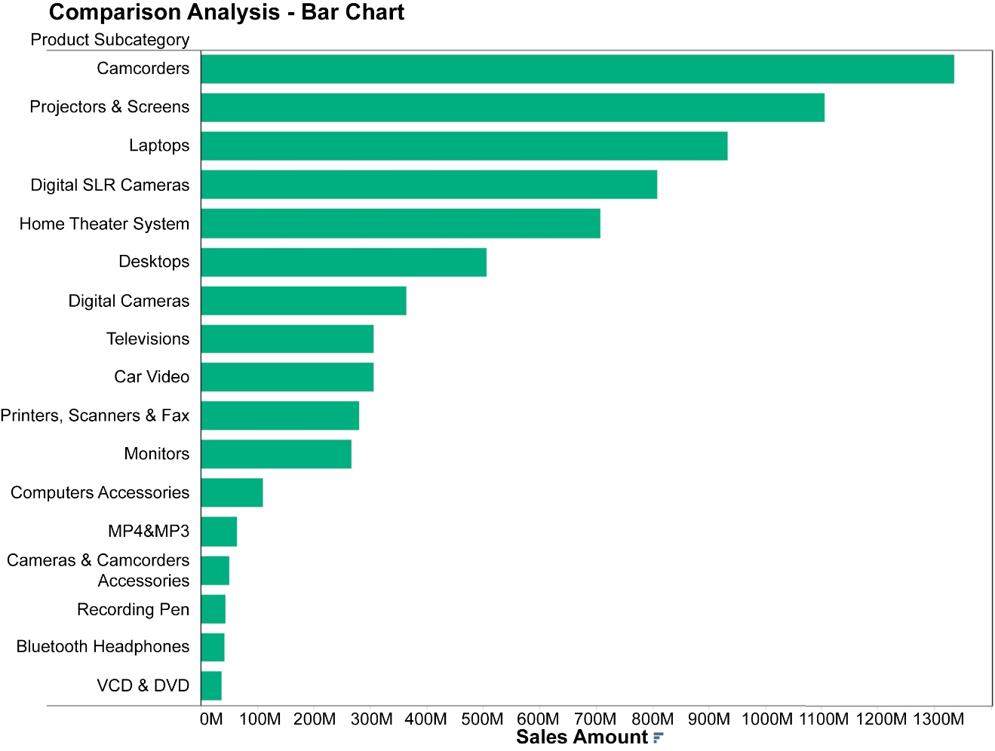
Matching Types of Analysis to Visualizations Comparative Analysis
People frequently compare and rank data. An enterprise, for example, will compare sales by categories of product and then rank those sales by the top products, as depicted in Figure 13.4.
Bar charts, as illustrated in the example, are very effective for comparative analysis because the lengths of the bars represent quantitative measures that can be compared quite easily. When ranking is important, sorting bars by the measure’s value enables a person to quickly discern the ranking order.
It is best to use one color for the bars rather than multiple colors, because it is easier to estimate the different bar sizes.
Horizontal bars work well for any number of items. Vertical bars work well with fewer than a dozen items.
f13-04

Slide 37
Matching Types of Analysis to Visualizations Time-Series or Trending Analysis
Examining trends over time, such as tracking sales is a very frequent analytical activity. Often the data tracked is broken down by some form of segmentation, such as product categories or by a person’s income level. The best visualizations for time-series analysis are:
line,
area, and
bar charts.

Slide 38
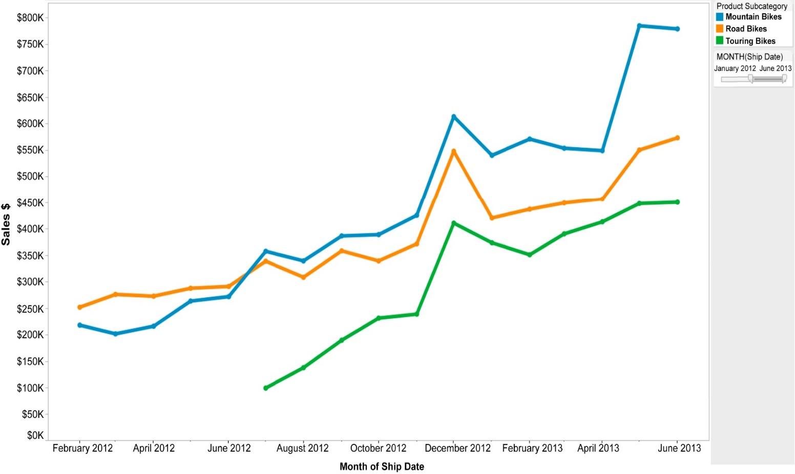
Trend analysis – line chart
Line charts are very effective at displaying segmented data as it changes over time, as depicted in Figure 13.5. Both the trends and relative differences in each of the segments are easy to discern. Different colors or line types often enhance usability.
f13-05

Slide 39
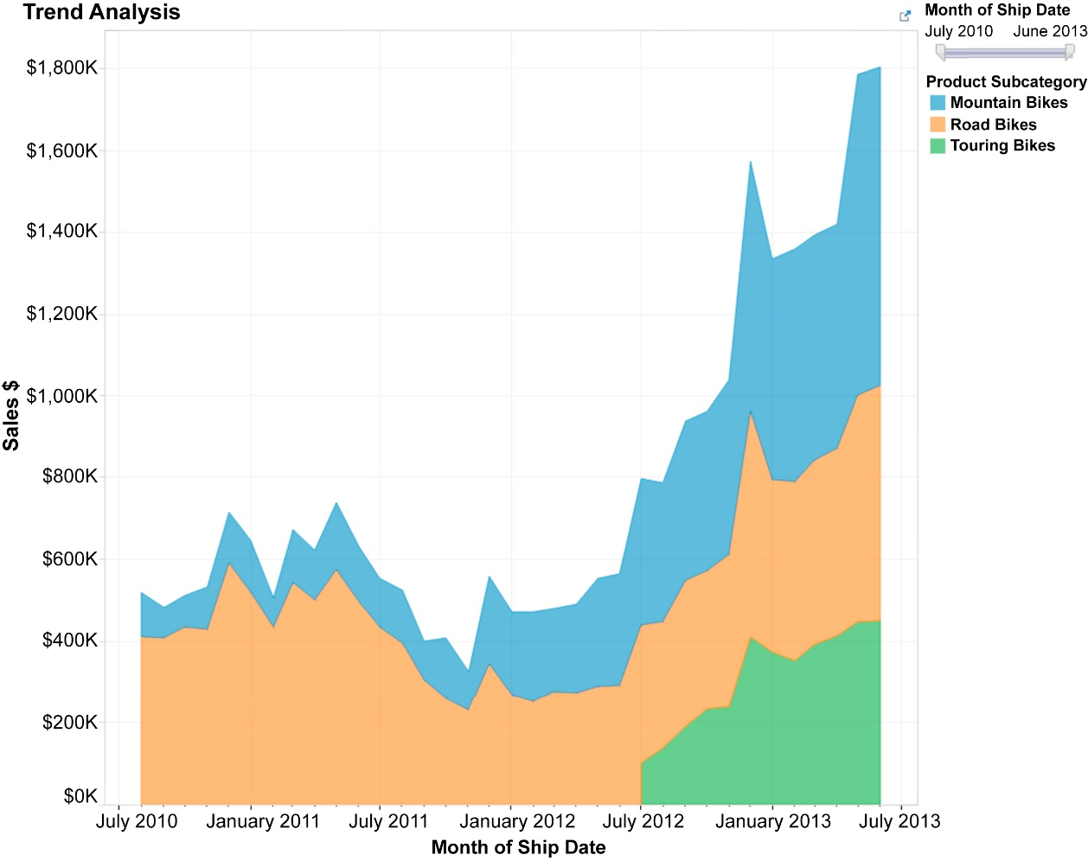
Trend analysis – area chart
Area charts are better than line charts if the person using the chart is interested in examining the trends, not only of the individual segments, but also their totals. Figure 13.6 illustrates how the segments and their total are highlighted using an area chart.
f13-06

Slide 40
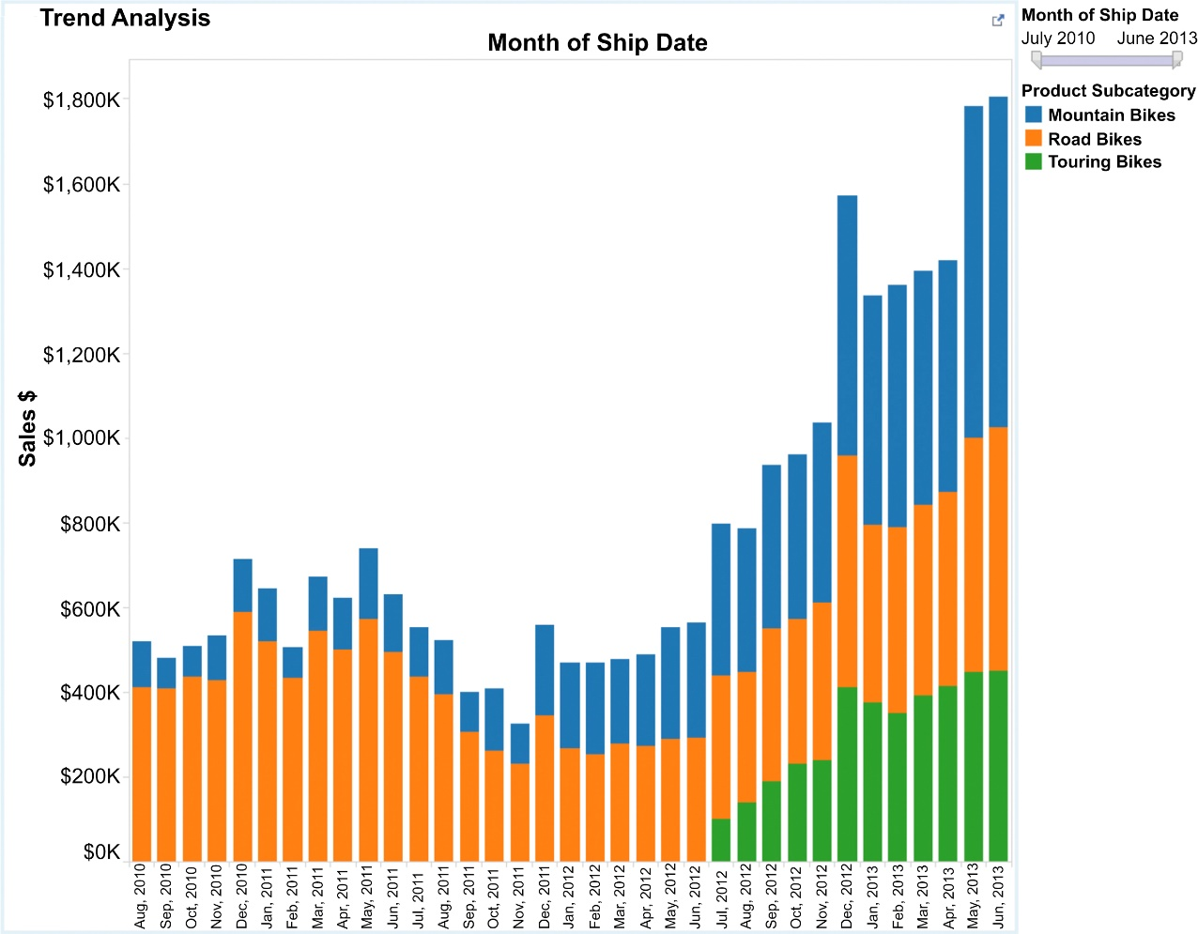
Trend analysis – bar chart
Bar charts, as depicted in Figure 13.7, are effective when there are only a few segments to be tracked or when each time period is discrete and people are not interested in seeing the trend, such as in a line chart
The convention for the trending charts is for time to be displayed horizontally on the X-axis while the measure is displayed on the Y-axis.
f13-07

Slide 41
Matching Types of Analysis to Visualizations Contribution Analysis
In this analysis, the contribution that each segment of something makes in relationship to the whole is typically represented by a percentage. The most common visualization used for this purpose is a pie chart, but it really is only effective when there are only a few elements to display, such as three or four.
When there are too many slices it is very difficult to compare the slices relative to each other, especially when they are nonadjacent. As the number of slices gets larger, use other visualizations. Bar charts where each bar is the same length and segments are sized by percentages support a larger number of segments than pie charts, but they still encounter an upper bound fairly quickly.
As shown in Figure13.8, the preferred contribution analysis visualization is the heat map, as it can accommodate a large number of slices, especially when a color gradient is used to enhance its usefulness.

Slide 42
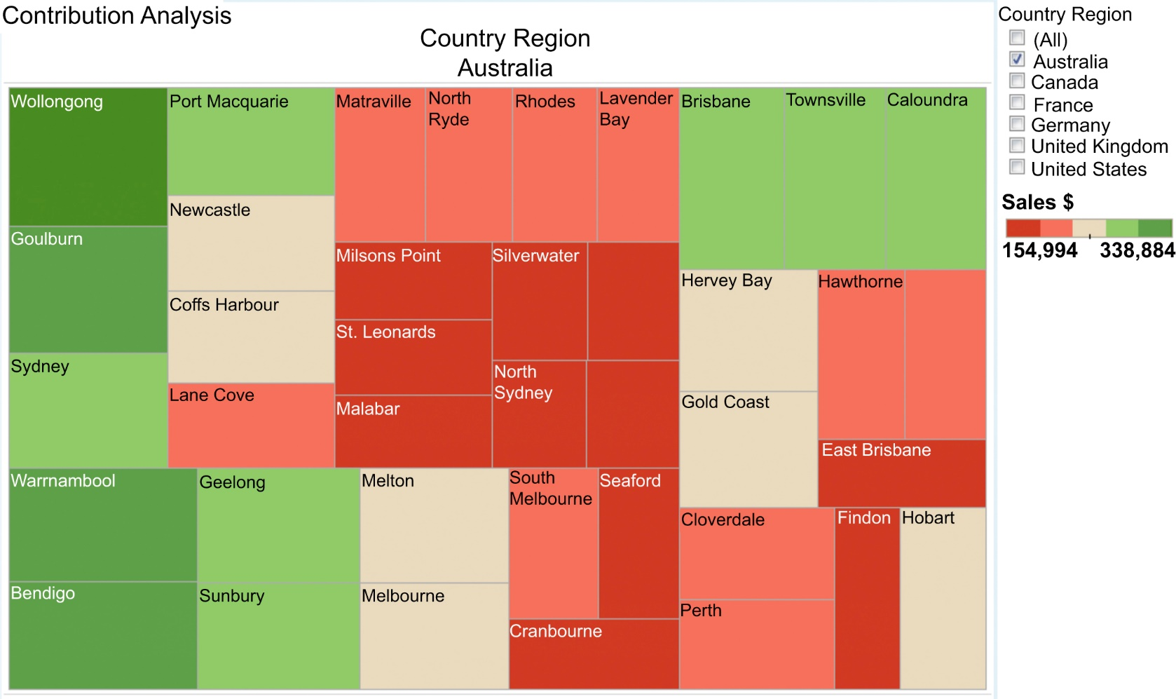
Contribution analysis – heat map
f13-08

Slide 43
Matching Types of Analysis to Visualizations Correlation Analysis
Visualizations are more effective than tables of numbers for enabling people to identify potential relationships among measures. This is especially true when there is a lot of data to show. Visually, people have become adept at discerning potential patterns.
Scatter plots (see Figure 13.9 for an example) are very effective for correlation analysis, especially when size and color are used to depict variation in the measure’s quantitative values. Also, combinations of line and bar charts are sometimes effective to support correlation analysis, especially when trend analysis is being used to identify correlations.
But be cautious, however, because a potential relationship does not guarantee a correlation. Validate causation prior to declaring there is a correlation.

Slide 44
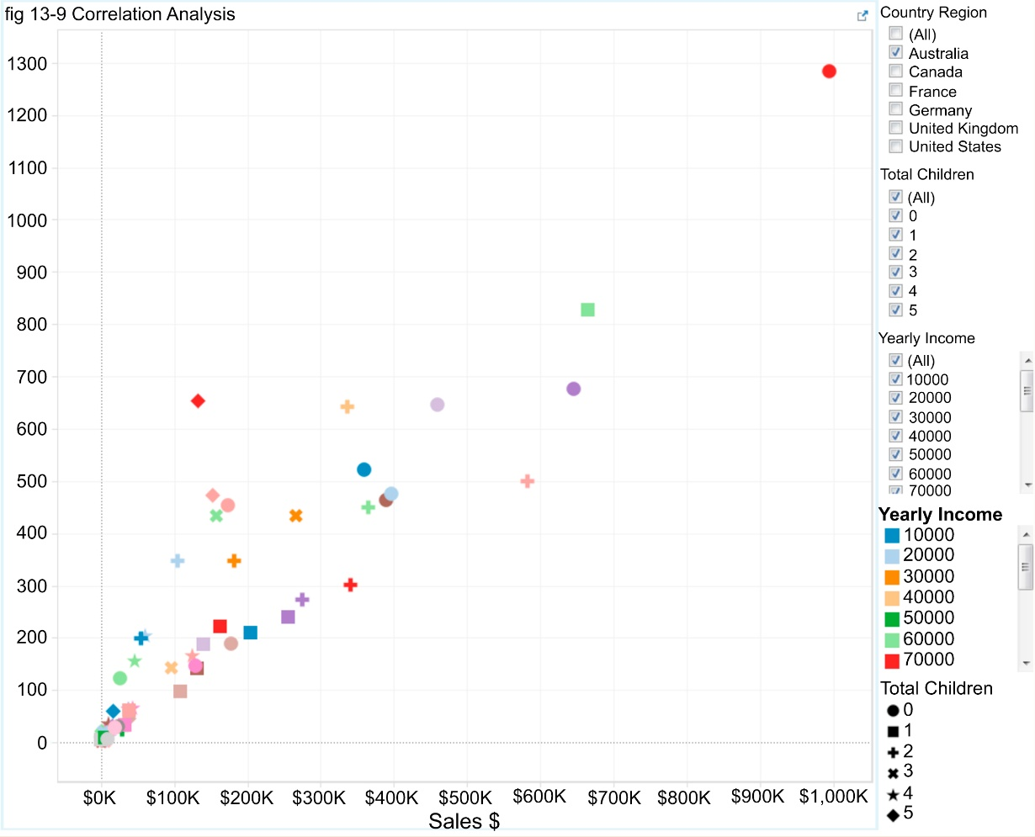
Correlation analysis – scatter plot
f13-09

Slide 45
Matching Types of Analysis to Visualizations Geographic Data
The most effective method to visualize data by location is to use a map.
Sales by the location of the retail store where the product was bought or by where the customer lives are excellent examples of how a map can show the distribution of sales.
See Figure 13.10 for an example.
Pairing an additional chart, such as a line chart showing trends or a data table providing the underlying detail with the map, is often very useful in enhancing the information conveyed.

Slide 46
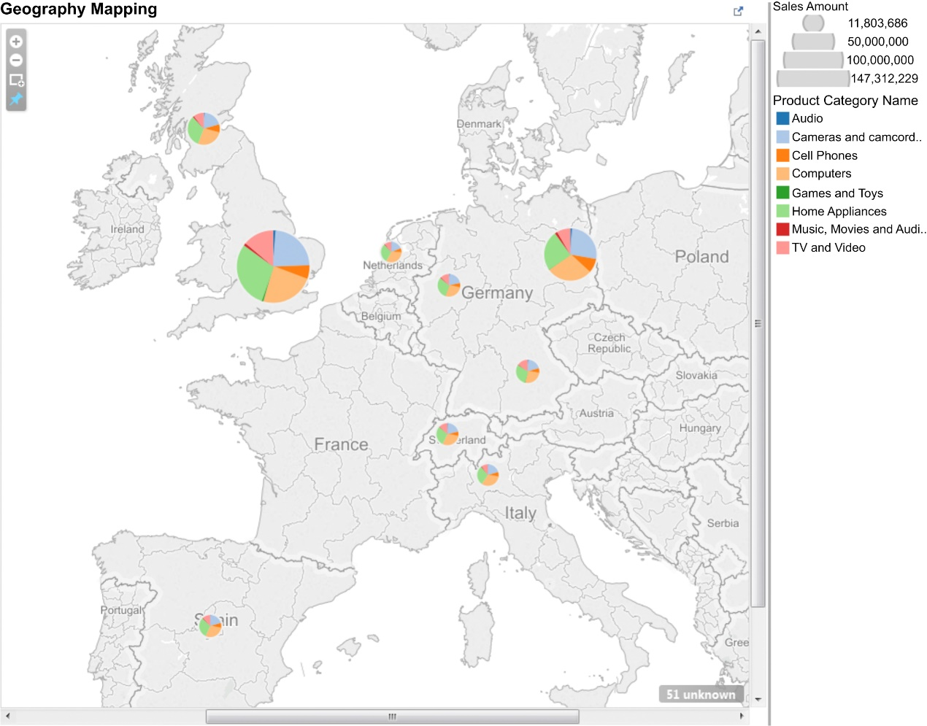
Geography mapping
f13-10

Slide 47
Matching Types of Analysis to Visualizations Distribution Analysis
This type of analysis displays the distribution of values across your full quantitative range. For example, call center talk time is examined by the length of call with its average, minimum, and maximum for different types of support calls.
The two visualization techniques used to support distribution analysis are:
box plots, and
histogram.
Figure 13.11 provides an example.

Slide 48
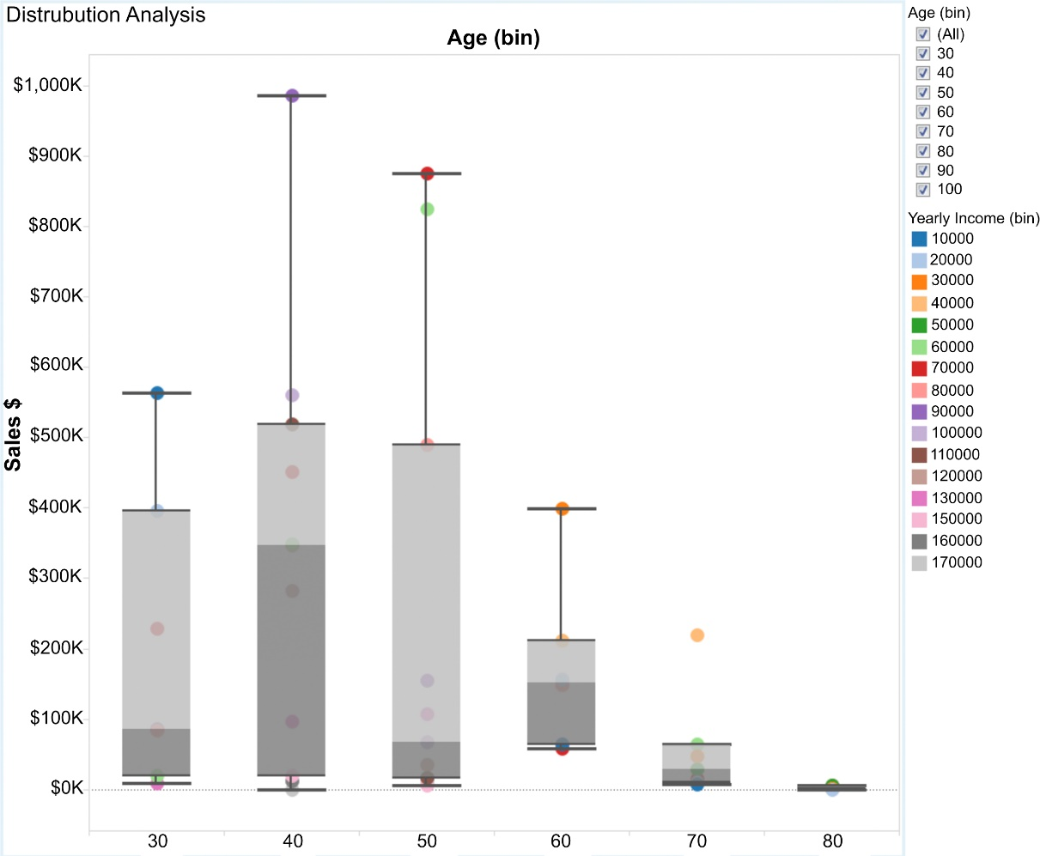
Distribution analysis – box plot
f13-11

Slide 49
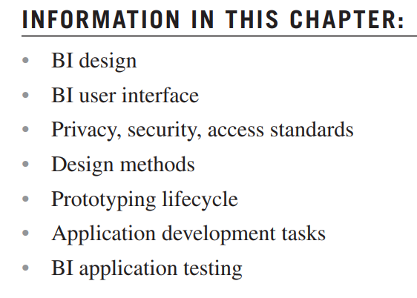
Chapter 14 BI Design and Development

Slide 50
BI Design
The business intelligence (BI) content specifications document all the data processes in the BI application— access, integration, transformation, and analysis.
The next step is to design the BI application’s visual layout and how it interacts with its users.
This includes creating and adhering to:
standards for the user interface, and
standards for how information is accessed from the perspectives of privacy and security.

Slide 51
BI Design BI User Interface (UI) Standards
Websites are designed with UI standards that make the layout, navigation, and functionality consistent across all pages.
This consistency makes us more productive; we can immediately use the Website for its intended purpose without having to figure out how it works.
Likewise, it is critical for the BI team to implement UI standards for all BI applications so people using them can focus on what they need to accomplish.
The Web and BI development communities face similar design challenges as depicted in Table 14.1.

Slide 52
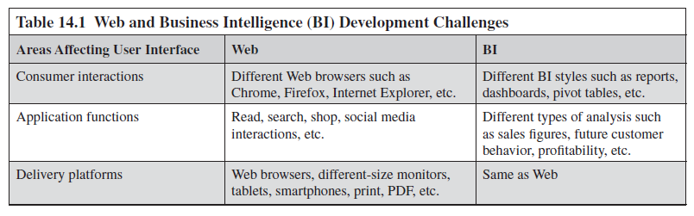
BI Design BI User Interface (UI) Standards

Slide 53
BI Design BI User Interface (UI) Standards (Cont.)
The Web community’s response to the various challenges it faced was to participate in an international standards consortium, World Wide Web Consortium, to develop UI standards covering customer-facing applications, application functionality, and delivery platforms.
These standards include HTML (hypertext markup language), DHTML (dynamic HTML), cascading style sheets (CSS), extensible markup language (XML), asynchronous JavaScript and XML (AJAX), portable network graphics (PNG), scalable vector graphics (SVG), and many others.
These standards, because product vendors adhere to them, ensure that the consumer has a consistent UI and the developers can concentrate on content rather than on all the differences in UI across the platforms, functions, and customer interactions.

Slide 54
BI Design BI User Interface (UI) Standards (Cont.)
On the other hand, the BI community still faces significant differences between vendors’ products and BI styles.
Although they follow a few standards, such as the database language and access protocols along with the Web standards just mentioned, those were agreed to by communities outside of BI.
When it comes to customer interactions and application functions, rather than collaborating on industry standards, the BI product vendors continue to either view the differences as their edge over the competition or see standards as actually being harmful by commoditizing their products.
This has resulted in differences between the various BI styles, how various product vendors implement the same BI style, and how the various analytical functions or charts are implemented. Because many BI product suites were created through product acquisitions, there is even an inconsistency in UI between the different tools within the suites.
The competition in the BI market has prevented the type of collaboration that is seen in the Web community, placing a burden on BI project teams to develop a group of UI standards to ensure a consistent UI experience for their customers.

Slide 55
BI Design BI User Interface (UI) Standards (Cont.)
The BI UI standards need to cover the following areas:
Layout standards specific for each BI style such as a report, dashboard, scorecard, or pivot table that is planned to be used.
Each of these BI styles has unique layout and functional characteristics that need to be standardized every time they are used within the enterprise’s BI applications. Examples of standardizations that need to be addressed include:
Dashboards and scorecards—the minimum and maximum number of panels that can be used, the sizing and orientation of those panels, to the position of filters in, and the workflow between panels and other dashboards.
Pivot tables—how dimensions and measures are displayed and selected.
Reports—whether production reports be pixel-perfect and static, what interaction people will have with the reports, how they will be delivered, and if people will be able to print or save reports as specific format.

Slide 56
BI Design BI User Interface (UI) Standards (Cont.)
Common layout standards need to be defined across all BI styles and delivery platform.
Layout—backgrounds, BI applications’ branding, and logos.
Text—fonts and styles for title, subtitles, labels, etc.
Color—color scheme for backgrounds, panels, labels, and chart types.
Filters, parameters, and slicers—how they are displayed, function, and are related to each other.
Delivery platform standards need to be defined for each medium in which the BI application will be used (e.g., Web browser, notebook, tablet, smartphone, print, PDF). This also includes determining how to handle the differences in wide-screen monitors and notebooks, each of which is being viewed on a Web browser but with size differences drastically affecting what a person can see and interact with on the screen.
Chart type standards need to be defined to match each type of analysis with the chart types that best supports it.

Slide 57
BI Design BI User Interface (UI) Standards (Cont.)
Many UI standards need to be developed for BI applications. It’s a good idea to develop these standards on an as-needed basis rather than dedicating a significant a front portion of the project to defining them. Developing UI standards on an as-needed basis has these advantages:
Supports an iterative and incremental approach, as advocated in Chapter 18, which in the long run will be faster than a waterfall methodology where all of the standards are defined up front, delaying when BI application deliverables reach the business people.
Defining the UI standards when they are needed provides the context of immediately available use cases.
Although some BI teams will create UI standards solely using text, it’s best to supplement text with one of the following visual techniques: sketches, wireframes, storyboards, or mockups to better depict what the UI will look like. The old saying a picture is worth 1000 words is absolutely correct in this instance.
And to obtain both developer and user feedback to better refine and validate standards. if time and resources permit, use a proof of concept, pilot, or prototype to implement the proposed UI standards in selected BI applications {Research Area!}.

Slide 58
BI Design Create Privacy, Security and Access Standards
Although privacy, security, and access are often intermixed, it is import to examine and establish standards for each.
First, establish standards for data that should not be disseminated because of regulations or a code of conduct. This can include data on customers, prospects, suppliers, employees, and more. In this age of Big Data and the Internet of Things, where the collection and analysis of data about people, places, and things is rapidly increasing, a BI team must work with the business to define standards and enforce them. This enforcement will extend to both business and IT.
Second, create security standards on how to determine what data needs to be secured and how that will be implemented in the BI applications. The implementation may involve establishing a data schema with the name and pertinent attributes to resolve security access. Enterprise security regarding the BI applications and the data that they access will involve business and IT staff beyond the immediate BI team and stakeholders. Networking, server, storage, database, and file access are all part of the security framework. BI security standards establish what the BI applications need to do to contribute to the overall enterprise security.

Slide 59
BI Design Create Privacy, Security and Access Standards (Cont.)
Finally, with privacy and security standards in place, a BI team can work with the business to define access standards. These standards are not about declining someone’s access for security or privacy reasons, but rather because it just makes them more productive. Typically, access standards specify BI consumers’ attributes that will determine their access right. For example, someone’s business group combined with their title, role, and location forms a set of attributes that many enterprises use to define access rights. The BI application using these access standards may expose data along product lines or geographies based on these attributes.

Slide 60
BI Design Designing Each BI Application
Using the BI content specifications and UI standards, the BI designers should design the visual layout and workflow of each BI application.
The deliverable of this design task is either a written specification or working prototype.
Just as with developing UI standards, using visual design methods improves the understanding of what is being proposed and encourages business people to provide feedback.
The various techniques that BI designers use in creating BI application specifications are depicted in Figure 14.1.
The methods are displayed in the order from left to right of increasing visual detail.
A guiding principle for selecting and using one or more of these visual design methods is that they should be done quickly and not become projects unto themselves. The deliverables from these methods are design needs, not masterpieces of art.
A working prototype may be used as a follow-on to any of the visual design methods or to replace these methods altogether. To develop a working prototype the following conditions must be met:
Target schema with sample data must be available
BI tool must be installed
Prototyping environment must be available
Team must have some level of development experience with a BI tool

Slide 61

BI visual design methods
f14-01

Slide 62
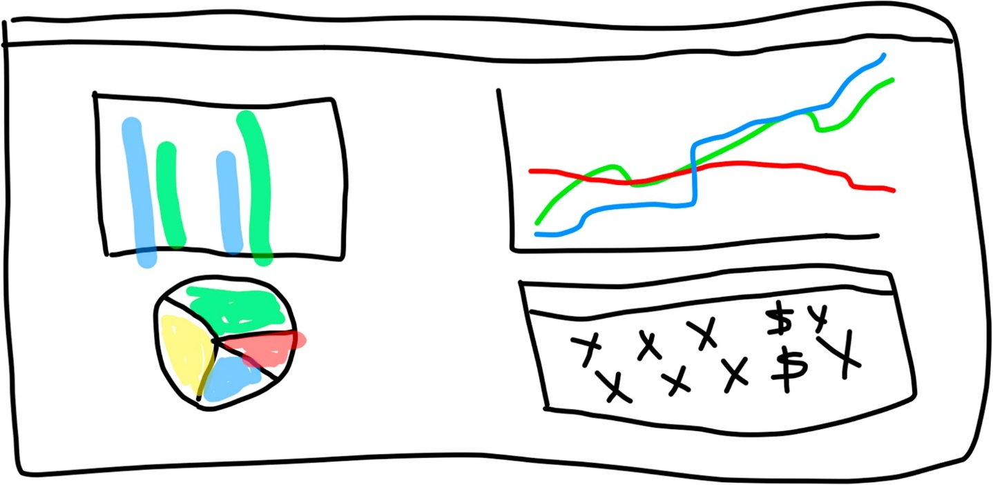
Whiteboard sketch
Sketches
Most visual designs will start off as a sketch as depicted in Figure 14.2.
Using a whiteboard or paper is a quick, easy, and inexpensive way to draw the initial sketches and begin discussions.
A drawback of using a whiteboard or paper is that it is difficult to get it into the specification document and share with others.
With that in mind, there are drawing applications that can save the output into various formats, and collaborative applications that enable sharing by providing a virtual whiteboard. Another benefit of these applications is that you can use prebuilt shapes, making the sketches faster to draw, but more importantly, much neater.
Sketches are a starting point for the visual design of BI applications, but they are still ambiguous and you need to add more detail using other visual design techniques.
f14-02

Slide 63
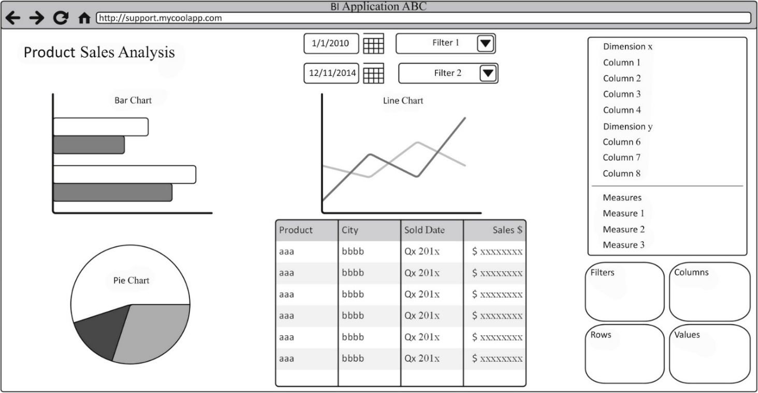
BI application wireframe
Wireframes
A wireframe portrays the visual structure of the BI application and provides the next level of detail beyond sketches.
The wireframe drawing contains:
Each data content group.
Content location in a layout.
A representation of the visualizations as a chart or table. Some wireframe tools have prebuilt. visualizations such as bar, line, and pie charts, but if your tools do not or the particular visualization that will be used is not a prebuilt icon, then use a box as a placeholder.
Description and placement of filters, sliders, titles, subtitle, text fields, logos, and any other layout item. Placeholder boxes are typical in those cases because this is a low fidelity design, and you want to do it quickly.
There are many inexpensive and easy-to-use wireframe tools. In addition, spreadsheets and presentation applications are commonly used because they are available and people already know how to use them.
The wireframe design process should be quick and inexpensive, without requiring sophisticated technical abilities.
A wireframe focuses on how the BI application screen layout will look rather than the navigation or the functionality involved, which is addressed by mock-ups, storyboards, and prototypes.
f14-03
A wireframe is referred to as a low fidelity representation of the design. A wireframe is similar to a blueprint (low fidelity) of a house rather than a three-dimensional CAD/CAM picture (high fidelity).
A convention for wireframes is that they are drawn in black, shades of gray, and white rather than in color. This convention is used to constrain the scope of the wireframe and focus its purpose.

Slide 64
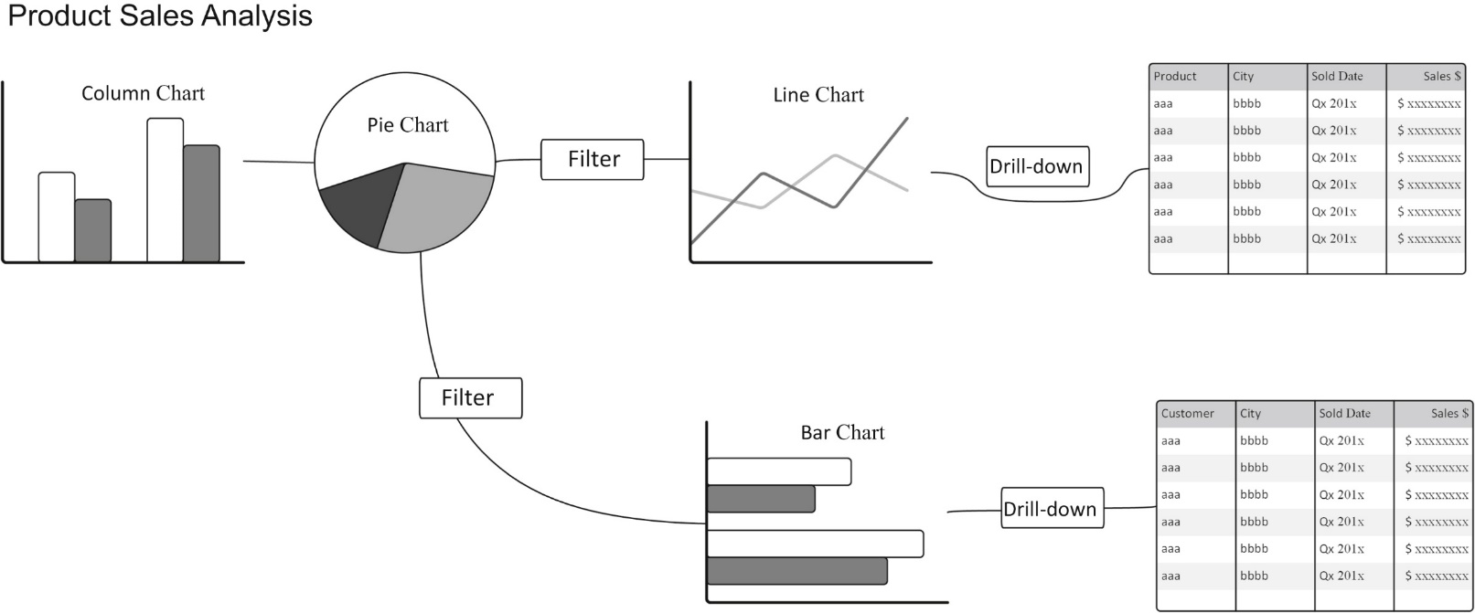
BI storyboard example
Storyboards
BI storyboards focus on the business user interaction of the analytical processes within the BI application. Storyboarding recognizes how business people actually work with BI applications such as a dashboard in order to gain insight into the business.
Business people will typically perform several analyses, some of which are dependent on each other, to determine if they need to perform some action and what that action is.
The storyboarding technique enables the BI designer gain a better perspective on how each type of analysis is related and enables the development of a more effective layout.
In the BI application depicted in Figure 14.3, the analytical processes or scenes are the comparison analysis (column chart), contribution analysis (pie chart), trend analysis (line chart), and detailed drilldown of the trend analysis (tabular grid). Figure 14.4 illustrates the workflow between each of these analysis processes laid out in sequence.
Storyboards are the most complete representation of visualization and workflow that a BI team can develop without constructing a working prototype.
f14-04

Slide 65
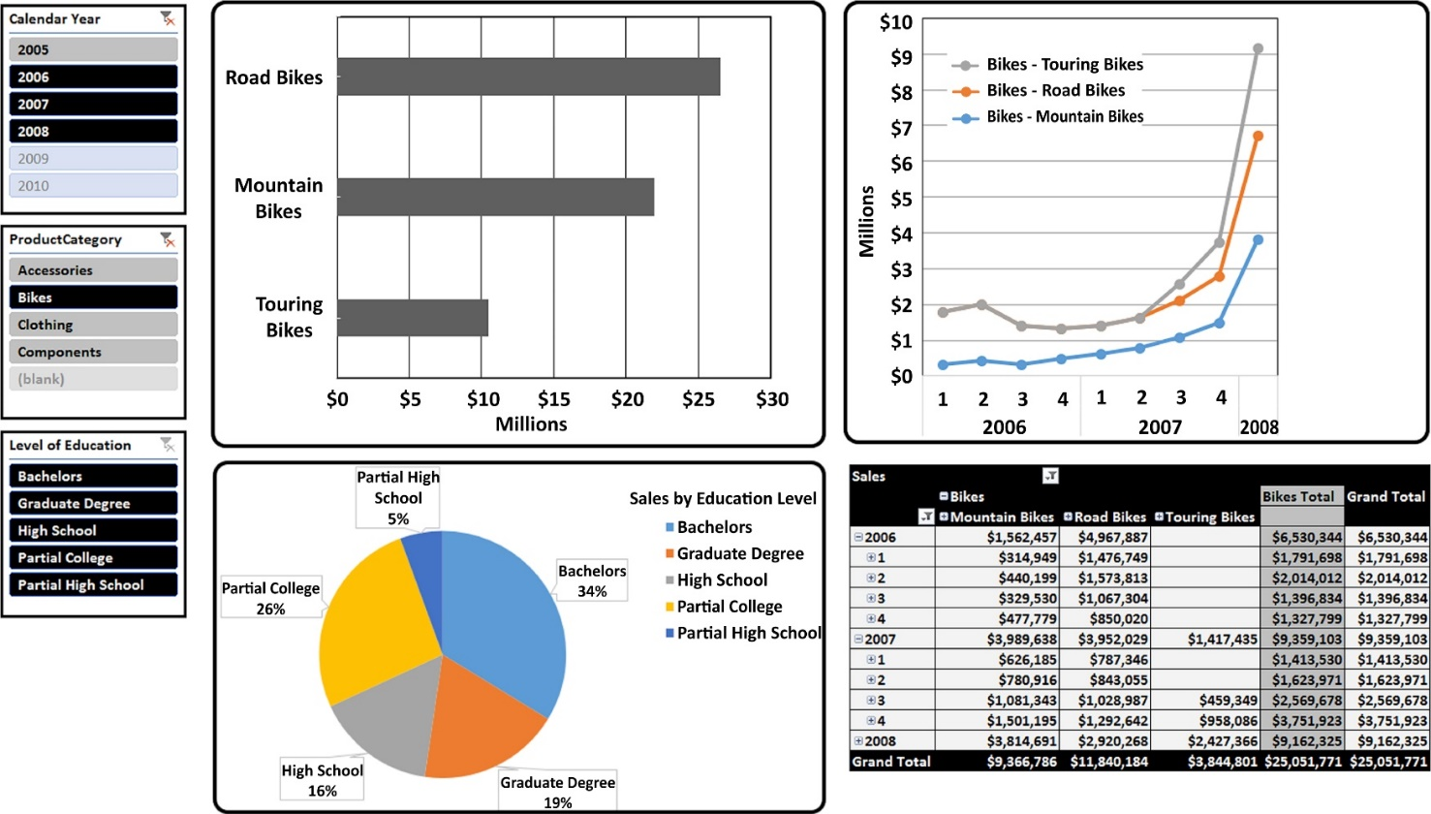
BI mockup example
Mock-ups
Mock-ups are the medium- to high-fidelity representations of the BI application’s layout. Returning to our analogy of the architectural drawings, the mockup is the three-dimensional CAD/CAM drawing of the house.
The mockup is a static visualization of what the BI application will look like to the business person, including the colors, icons, buttons, text, and charts that will be used. It is a static representation so that business people cannot actually interact with it, but will be able to see what they will work with once it has been developed.
Figure 14.5 depicts a mockup of the wireframe in Figure 14.3.
This is not a typical situation in most BI projects because the BI tools can create a prototype of the actual BI application’s layout much more quickly than a mockup tool. In addition, the BI prototype can then be used to template. For these reasons, mockups are typically not used unless the BI tool creates them along with the prototype.
f14-05

Slide 66
BI Development
From a development perspective, the BI team needs to build the BI applications incrementally and iteratively by using prototyping.
Business people are always getting surprised when BI applications are implemented. They will say that the application doesn’t do what they asked for, is providing results different than expected or they need to add something they forgot to ask for.
This scenario plays out time and time again. It is exacerbated when teams use a waterfall project methodology in which business people are engaged to gather requirements in the early stages of a project. Then, weeks or months later, when business people are reengaged to test the completed BI application, they notice different things.
Although it’s still a good idea to do the requirements early in the project to define scope, ensure that the overall framework is built, and to get the data in place for BI application development, switch to prototyping mode when you get to the BI application development phase. This gets people actively involved in a feedback loop and avoids the implementation surprises that plague so many BI projects.

Slide 67
BI Development Prototyping Lifecycle
Software prototyping is a technique to build specific portions of an application to investigate certain aspects such as functionality, feasibility, efficiency, performance, or how well it meets requirements.
There are two primary objectives for BI prototypes:
Obtain feedback from its intended users.
Enable developers to build BI applications in an incremental manner.

Slide 68
BI Development Prototyping Lifecycle (Cont.)
There are several critical success factors in the BI prototyping efforts:
Dedicate time and effort. Business people who will be using the BI applications in their jobs need to be actively involved in working with the BI prototypes and providing feedback to the BI developers. Business management needs to make a commitment that these people will have dedicated time assigned to these prototyping tasks. The BI team should create a schedule with times and tasks for these business people to participate in prototyping.
Work incrementally. Although there are software prototypes that are either throwaway or only work on part of an application, you’re better off using a BI prototype that incrementally builds the entire BI application. This type of prototyping may be referred to as incremental, evolutionary, or extreme.
Time-box it. The prototypes are rapid and time-boxed. This approach keeps both the developers and business people focused and better able to manage their time (the business people will have their “regular” jobs to complete besides the prototypes). Building the BI application in small and discrete increments enables a more thorough examination and validation when the prototyping is completed. Using this approach, you can develop and test incremental prototypes within hours..

Slide 69
BI Development Prototyping Lifecycle (Cont.)
The BI prototyping lifecycle as depicted in Figure 14.6 consists of the following tasks and feedback loops:
Define the prototype scope. Determine the component that will be developed. Identify the participants (developers, reviewers, and manager). Define the objectives, deliverables sign-off criteria (success criteria), and the timeline. If the team is using a rapid prototyping or agile approach then this step may be completed in a single meeting.
Create BI application prototype. Build the assigned component of the BI application. The assumption is that it will be built with the BI tool selected to deploy the BI application. The prerequisites are that a development environment exists and, at a minimum, sample data from the BI schema is available.
Conduct unit tests. The developer runs the prototype and examines test results. If changes are required, then revisions are made and the test is rerun. The prototype should only be passed along to the business people to conduct their own tests if it has passed the unit tests. If not, the developer informs the business people of any outstanding issues.

Slide 70
BI Development Prototyping Lifecycle (Cont.)
Users test prototype. The business people test and assess the prototype. Over the course of the incremental prototypes, business people will test the data, UI, and types of analytics offered.
Gather user feedback. The intent is to more actively involve business people in the development process to solicit their feedback and improve the overall BI application.
Revise as necessary. If the prototype has serious flaws or shortcomings, then it should be revised and that prototyping lifecycle repeated. If the issues are minor or need to be investigated further, then implement any changes and test them in the final prototyping step that involves the overall BI application.
Prototype signoff. For the individual components that are prototyped, a signoff indicates the next prototype can proceed. For the final prototype, the signoff indicates that the

Slide 71
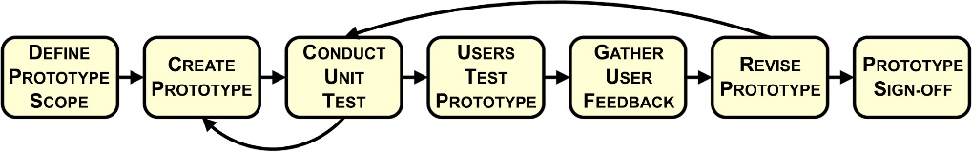
BI prototyping
f14-06

Slide 72
BI Development BI Application Development Tasks
BI prototyping is used for one or more of the following reasons:
Validate, expand, or gather business, data, and technical requirements
Engage business people to work with and provide feedback
Determine feasibility of specific functionality
Examine effectiveness of components built
The BI team may use prototyping to flush out the requirements (reason 1 listed previously) for the BI design. Prototyping may be used to determine either the BI content or the types of analytics that will be used in the BI application UI. If prototyping is used for design purposes, the BI team needs to document the design by using the BI tool’s documentation capabilities. The prototype itself should be saved as part of the documentation.
BI prototyping is the best practice technique to develop BI applications (reasons 2-4 listed previously). The BI application will be divided into the following three components:
Create data content
Create data chart or visualizations for analysis
Create overall BI application
The BI prototyping lifecycle is depicted in Figure 14.7.

Slide 73
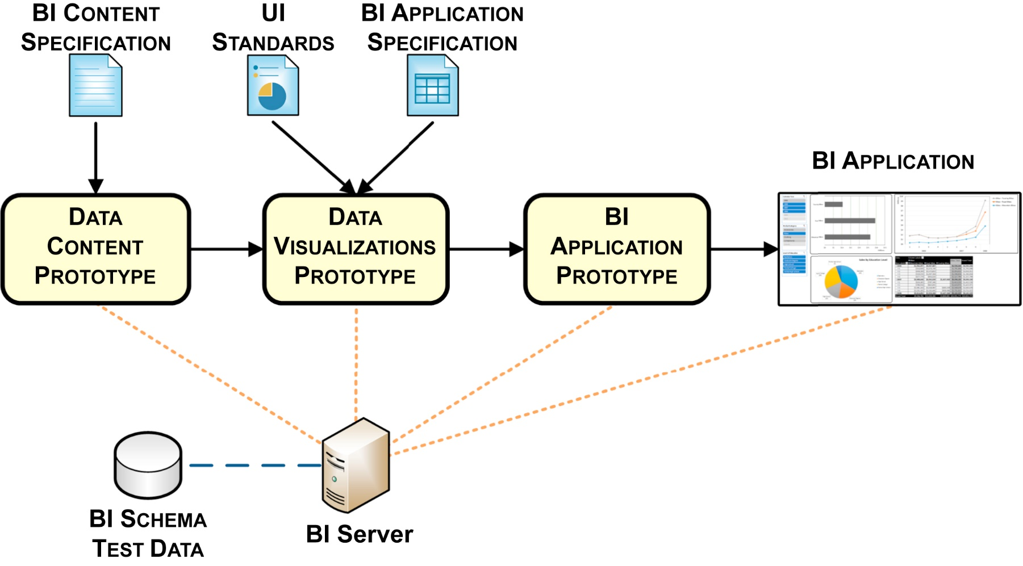
BI application development lifecycle
f14-07

Slide 74
BI Development BI Application Development Tasks/Create data content
The objective of this task is to get the data required for the analysis that will be performed using the BI application.
At a minimum, this includes connecting to the required data sources, executing queries to gather the data, creating the schema used by the BI tool, examining the query results, and testing if the data is valid.
If the data sources are relational databases, then use open database connectivity (ODBC), java database connectivity (JDBC), or direct database connections. Nonrelational sources will require connection information filled into source-specific application programming interfaces (APIs).
BI tools typically provide all the prebuilt connection APIs that a BI developer would need, but there are ways to supplement those if necessary.

Slide 75
BI Development BI Application Development Tasks/Create data content (Cont.)
Typically, BI developers have several options for querying the data:
Specify the data sources, often tables or files, and use the default setting of getting all the available columns or fields from that source.
Specify the data sources and filter the columns (and any rows) that are retrieved.
Write a custom-coded SQL statement (or whatever the equivalent is in the data source you are accessing) to get the rows and columns required.
When pulling data from more than one source table or file, use joins to gather the correct information. The typical options provided by the BI tool are as follows:
The BI tool will join tables either by assuming that identical names in different tables imply a primary and foreign key relationship, or by querying the source database’s metadata to identify columns designated as primary and foreign keys.
The BI tool provides a visual application or a scripting language for the BI developer to designate primary and foreign keys. This may be the primary means to assign these keys or it may be how a BI developer would override assumptions that the BI tool had made regarding the key relationships.
Write a custom-coded SQL statement (or whatever the equivalent is in the data source you are accessing) to join the appropriate tables.

Slide 76
BI Development BI Application Development Tasks/Create data content (Cont.)
The scope of creating and modifying the schema used by the BI tool, often called a repository, will depend on whether the business person accesses the schema to perform analysis or relies on prebuilt filters and drop-down lists to select data.
Self-service BI applications such as data discovery, OLAP cubes, and pivot tables are the type of application requiring the business person to access the schema.
When this happens, the BI developer may need to modify the BI tool schema to make it easier to use by doing the following:
Creating user-friendly names for columns
Removing columns that are never used
Creating relationships not found in the data sources needed for analysis
Creating new measures
Implementing business algorithms
Creating aggregations
This is typically performed using visual applications; however, some BI tools may require scripting.

Slide 77
BI Development BI Application Development Tasks/Create data chart or visualizations for analysis
To select the best data chart or visualization, the BI developer examines the type of analysis that the business person is going to perform and the data that it will use.
After the data content has been loaded, the BI developer creates each data chart individually and tests how well it meets business requirements.
After these tests, business people should get a chance to provide feedback on each of these data charts. This is not a formal user acceptance test (UAT), but rather one of several checkpoints in the development lifecycle to get feedback as the BI application is being incrementally built.

Slide 78
BI Development BI Application Development Tasks/Create overall BI application
Once all the data sources have been set up and each data chart has been built it is time to create the overall BI application.
This means putting all the individual components into the overall BI application layout, establishing the navigation capabilities, implementing the UI standards and interconnecting the components as needed to support business requirements.
Once the overall BI application has gone through its prototyping tasks, then it will proceed into the BI application testing lifecycle discussed in the following section.

Slide 79
BI Application Testing
It is best to conduct BI application testing iteratively and incrementally as discussed in Chapter 18. BI testing is a collaborative effort between BI developers and business people whose involvement in working hands-on with the BI applications started with the BI prototyping tasks.
As depicted in Figure 14.8, there are three testing phases: unit, BI applications, and BI systems.
The following tasks need to be performed:
Developer unit tests.
BI developers test each BI application after it has been built. The developers verify that the BI application operates in accordance with the BI specifications as they interpret them.
This is a technical test of the application. If the developers discover any issues that would hinder business people from testing the application, then they should notify them and try to fix whatever is preventing the application from moving forward.

Slide 80
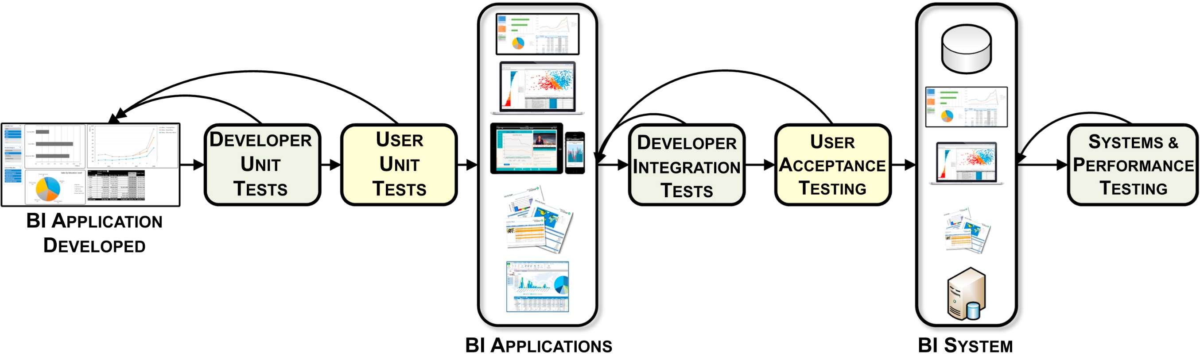
BI application testing
f14-08

Slide 81
BI Application Testing (Cont.)
User unit tests.
Business people test each BI application to verify that the application accesses the right data and performs the requested type of analysis.
Business people will check that the UI’s navigation and workflow support the work they plan to perform using this application. Also, business people should present any feedback, concerns, or issues they have with using the BI application.
They and the developer should agree on whether the BI application is set to move on to the next phase or if fixes or modifications are necessary.
Developer integration tests.
BI developers will test all the BI applications that are planned to be released using “real” data rather than sample data that might have been used in unit tests. The real data should either be from a production environment such as a data mart, OLAP cube, or data warehouse, or from a testing environment that has the planned BI schema along with a representative subset of production data.
The purpose is to verify that the BI applications can handle the real data and that the application functions correctly technically.
If these conditions are met then UAT can commence.

Slide 82
BI Application Testing (Cont.)
UAT.
Using the same data as the developer integration tests, the business participants will validate that all BI applications access the right data, perform the appropriate analysis, and have UIs that are sound. The business people have the authority to provide the yes/no decision regarding the release of the BI applications. The business and technical sign-off criteria should have been established for the data, analytics, and UI before the UAT.
System and performance testing.
This involves testing the entire BI system including databases, data integration, and BI.
Performance tests should be conducted on the entire BI system including databases, data integration, and BI. If possible, create stress tests to simulate current estimated peak load and anticipated peak levels over the next 2 years.
A BI testing plan listing test cases with acceptance success criteria needs to be developed, documented, and signed off by the appropriate responsible parties prior initiating the BI test lifecycle.

